Slide 1

KneeVision
Team S.T.A.R Labs

Slide 2

Agenda
01
02
03
04
05
PROJECT OVERVIEW
PRODUCT BACKLOG
TEAM METRICS
PRODUCT
SPRINT 1 RECAP
Research Team
Improvements
Project Description
Team Working Agreement
Personas
MVP
Languages and Tools
Algorithms
Diagrams
User Stories
Sprint 2 Stories
Test Cases
Team Velocity
Burndown Charts
Completed/Committed Ratio
Sprint 2 Retrospective
Sprint 3 Planning
API
Live Application Demo

Slide 3
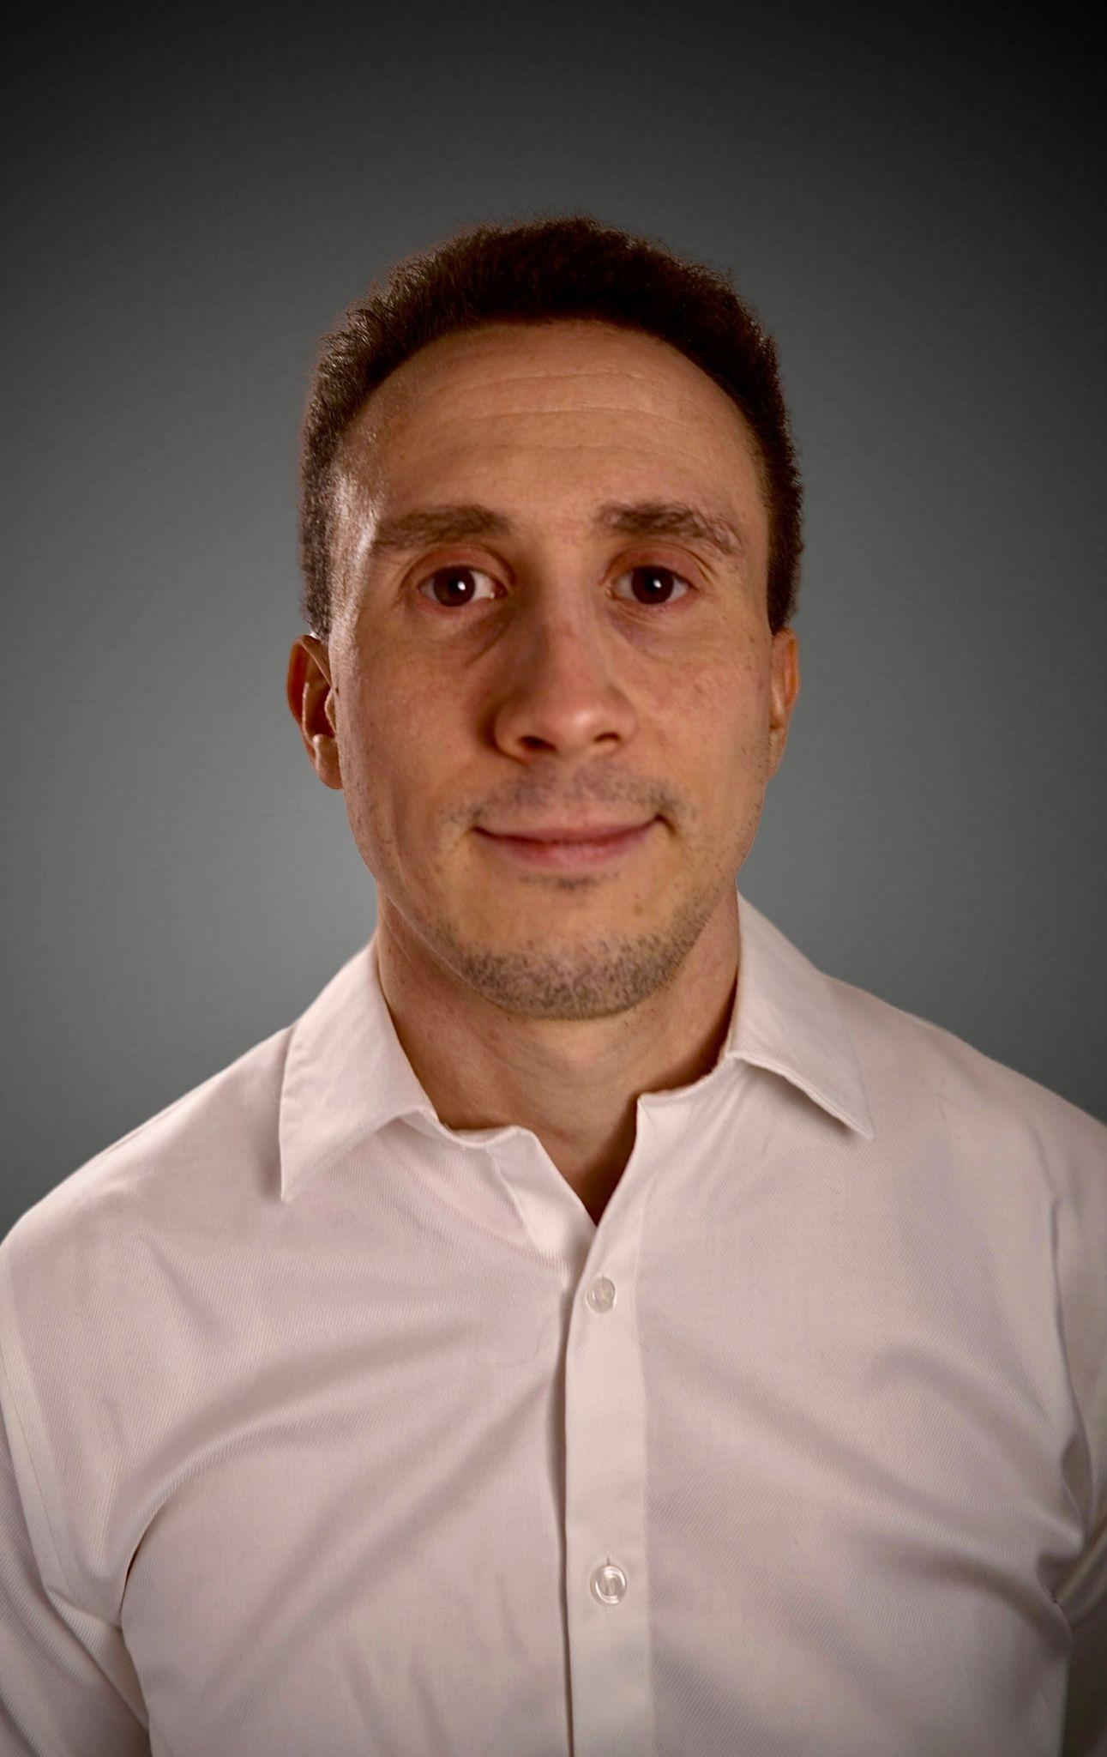

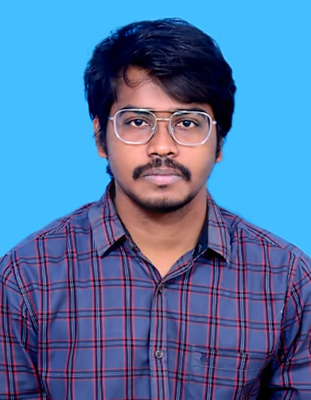
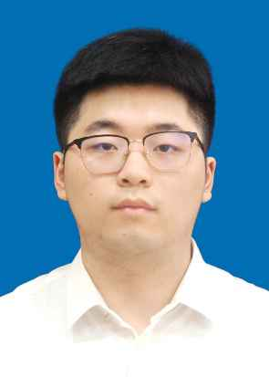
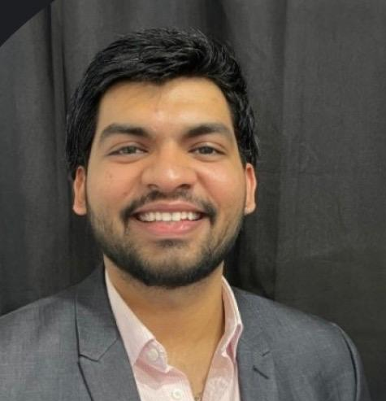


Our Research Team
Daniel Fox
Team Leader/
Developer
Manohar Killamsetti
Scrum Master/Developer
Siming Li
Developer/Tester
Sarvesh Shah
Cloud Developer
Swatej Goud
Backend Developer
Deep Patel
ML Developer

Slide 4
Improvements
Added more information for the model pipeline overview including diagrams, datasets used, and generating synthetic data (slides 21 - 25)
Updated the ER diagram (slide 28)
Color-coded the sprints in the product/sprint 2 backlog (slides 33 - 37)
Added charts instead of screenshots for the project schedule, product backlog, and test cases sections (slides 38 - 51)
Added charts to Team Velocity and Completed/Committed Ratio slides (slide 52 + 54)

Slide 5
Problem Statement
Knee X-ray imaging is commonly used to evaluate osteoarthritis, yet interpreting radiographic signs of disease severity can be subjective and inconsistent due to subtle visual differences and reliance on manual assessment. While advanced imaging techniques such as MRI provide greater detail, they are expensive and less accessible. This creates a need for scalable and consistent analysis methods that can assist in assessing knee osteoarthritis using widely available X-ray images.

Slide 6
Project Definition
A web-based platform that uses deep learning to analyze knee X-ray images for knee osteoarthritis severity assessment.
Intended for individuals, researchers, and clinicians seeking consistent and scalable analysis of knee X-ray data.
Leverages publicly available datasets and established convolutional neural network (CNN) models.
Designed as an AI-assisted decision-support and research tool, not a diagnostic system.
Benefits include improved consistency, scalability, and reduced subjectivity in manual X-ray interpretation.

Slide 7
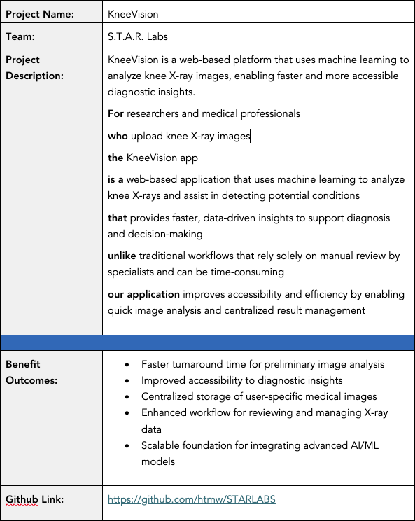
Project Description

Slide 8
Team Agreement: Collaboration Standards
Meeting Pattern
Synchronous sessions twice weekly (Sun/Tue). Mandated Agenda
documents for every session.
Continuous async sync via WhatsApp/Discord.
Decision Making
Majority-vote consensus based on researched evidence. Inclusive voicing of concerns during all discussion phases.
Technical Workflow
No direct pushes to Main. Isolated feature branches only.
Peer Approval. Every PR requires at least one secondary reviewer.
Jira Hygiene. Mandatory linking of work to Jira tracker IDs.
Blockers. Resolve locally & document attempts before escalation.

Slide 9
Team Agreement: Definition of “Done”
Category | Standard for Completion
Execution | Code runs without syntactical or runtime errors.
Compliance | Work meets all Industry Standards.
Verification | Work reviewed by multiple members & verified on multiple systems.
Documentation | All necessary docs tagged or updated along with code push.
Testing | All pre-defined test scenarios must be passed.

Slide 10


Persona - 1: The Practitioner
ORTHOPEDIC SURGEON | URBAN TEACHING HOSPITAL
Dr. Sarah Chen, 42
An expert in orthopedic medicine with 15 years of experience. Sarah operates in high-volume clinics where diagnostic speed is paramount to patient throughput and surgical triage.
KEY GOALS
Rapid knee X-ray triage
Fatigue from patient volume
Reduce initial assessment time
Reader reporting variability
Limited case analysis time
Validation for borderline cases

Slide 11

Persona - 2: The Research Coordinator
CLINICAL RESEARCH COORDINATOR
Alex Rodriguez, 29
A data-centric professional managing multi-site studies. Alex focuses on standardization, data integrity, and inter-rater reliability across large datasets.
STRATEGIC GOALS
•
Standardize severity grading
Efficient batch processing
•
•
Structured data exporting
Ensure rater reliability
OPERATIONAL PAINS
Manual grading inconsistency
Lengthy training cycles
•
•
Audit trail requirements
•
•
Historical data re-analysis

Slide 12

Persona - 3: The Learner
3RD YEAR MEDICAL STUDENT
Maya Patel, 24
A digital native in her clinical rotations. Maya uses the platform as a pedagogical tool to build pattern recognition skills and diagnostic confidence before her residency.
LEARNING GOALS
ACCESS OBSTACLES
•
Identify radiographic signs
•
Limited diverse case access
•
Immediate feedback practice
•
Assessment uncertainty
•
Grade/Clinical correlation
•
Limited attending time

Slide 13
What will our MVP be?
Web-based interface
Image preprocessing pipeline
Deep learning model
Severity assessment output
Basic result visualization
Mobile-responsive UI

Slide 14
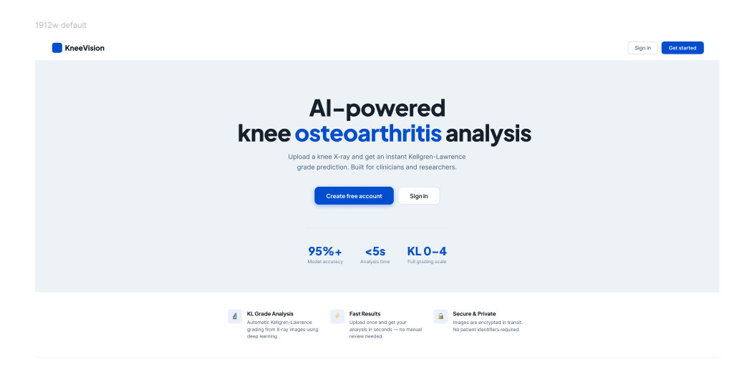
Project Design (Figma)

Slide 15
















Tools & Technologies
Languages:
Frontend:
Backend:
ML/DL Libraries:
Database:
Cloud:
Tools:
ML Inference:
Misc. Libraries:

Slide 16




FRONTEND
React · Vite · Tailwind CSS · TypeScript
React 18
Vite
Tailwind CSS
TypeScript
Component-based UI
Build toolchain
Utility-first styling
Type-safe JavaScript
Open-source JavaScript library for interactive UIs
Lightning-fast HMR and dev server startup
Direct utility approach replaces custom CSS files
Static typing catches errors at compile time
Reusable component architecture for maintainability
Instant compilation during development
Consistent design tokens across all components
Typed props and API response interfaces
State management with useState and useEffect hooks
Optimised production builds with tree-shaking
Responsive layouts with mobile-first breakpoints
Improves IDE autocomplete and refactoring
Pages: Landing, Login, Register, Upload, Gallery
Configured with Vite proxy to backend
Dark-mode ready with zero extra config
Compiled to JavaScript for browser execution

Slide 17




BACKEND
Node.js · Express.js · JWT · bcrypt
Node.js
JavaScript runtime built on Chrome's V8 engine. Enables server-side JS execution with non-blocking I/O for high concurrency — perfect for handling multiple concurrent upload and analysis requests.
Runtime environment
Express.js
Minimal and flexible Node.js web framework. Handles all REST API routes: auth (register/login), image presign, raw file upload, image metadata registration, and image retrieval with JWT middleware.
Web framework
JWT Auth
JSON Web Tokens secure every protected route via the requireAuth middleware. Tokens are signed with a secret, expire in 1 hour, and carry userId + email so any route knows who made the request.
Stateless authentication
bcrypt
Industry-standard adaptive hashing algorithm. Passwords are never stored in plain text — bcrypt hashes with salt rounds of 10, making brute-force attacks computationally infeasible.
Password hashing

Slide 18


DATABASE & CLOUD
MongoDB · AWS · Local filesystem
MongoDB
AWS / Cloud
NoSQL document database
Cloud infrastructure (planned)
users collection
Amazon S3
Stores email, hashed password, userId, timestamps
Object storage for uploaded X-ray images at scale
images collection
EC2 / Lambda
fileUrl, originalName, contentType, uploadedBy { userId, email }
Scalable compute for Express backend and ML inference
predictions collection
CloudFront
imageId FK, klGrade, confidence, probabilities, modelVersion
CDN for fast global delivery of static assets
Indexing
Current dev
Unique index on users.email prevents duplicate accounts
Local filesystem /uploads/ used during development

Slide 19






DEVOPS & TOOLS
Docker · GitHub · Jira · VS Code · Jest · Vitest
Docker
GitHub
Jira
Containerises the Express backend and ML service so the environment is identical across dev, staging, and production machines.
Version control and collaboration. Feature branches, pull requests, and code review. CI/CD pipeline triggers test suite on every push.
Agile project management. SCRUM board tracks sprints (SCRUM-18 register, SCRUM-19 login, SCRUM-20 image upload). Backlog prioritised by story points.
VS Code
Jest + Vitest
ESLint + Prettier
Primary IDE with TypeScript, ESLint, and Prettier extensions. Integrated terminal runs both Vite dev server and Express backend simultaneously.
Backend unit and integration tests with Jest (86 tests, ~89% coverage). Frontend component tests with Vitest + React Testing Library.
Code quality enforced at save. ESLint catches bugs, Prettier formats consistently. Husky pre-commit hooks block bad commits.

Slide 20
Model Pipeline Explanation
Dataset: Mendeley Dataset (8260 Images)
Model Plan:
Cleaning Dataset (Manually deleting the the defective images and cropping to ROI [Region of Interest])
Generating synthetic data using DCGAN (Deep Convolutional Generative Adverserial Network)
Preprocessing (Enhancing images using Adaptive Histogram Equalization [AHE])
Using Pre-Trained Models
Metrics Evaluation

Slide 21
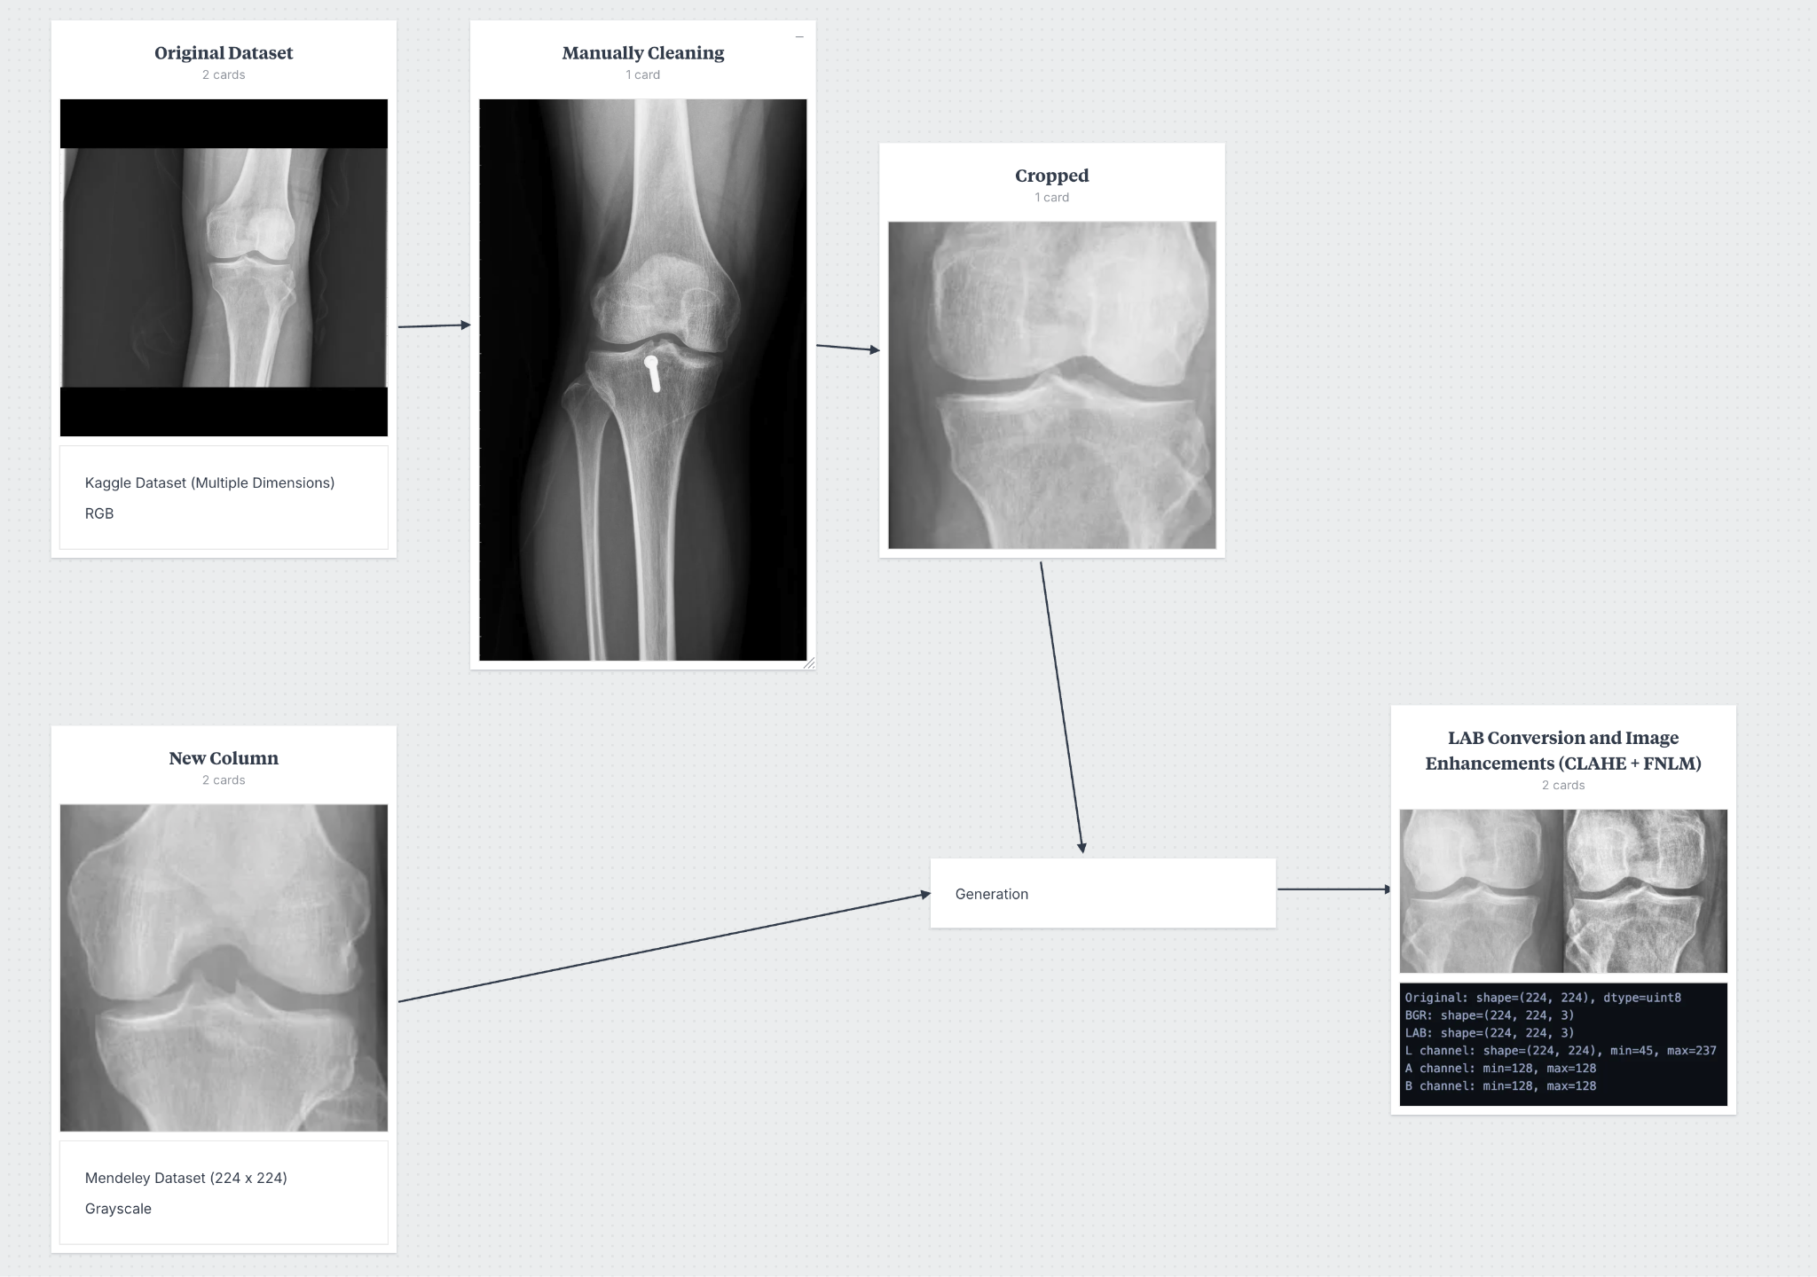
Model Pipeline - Dataset

Slide 22
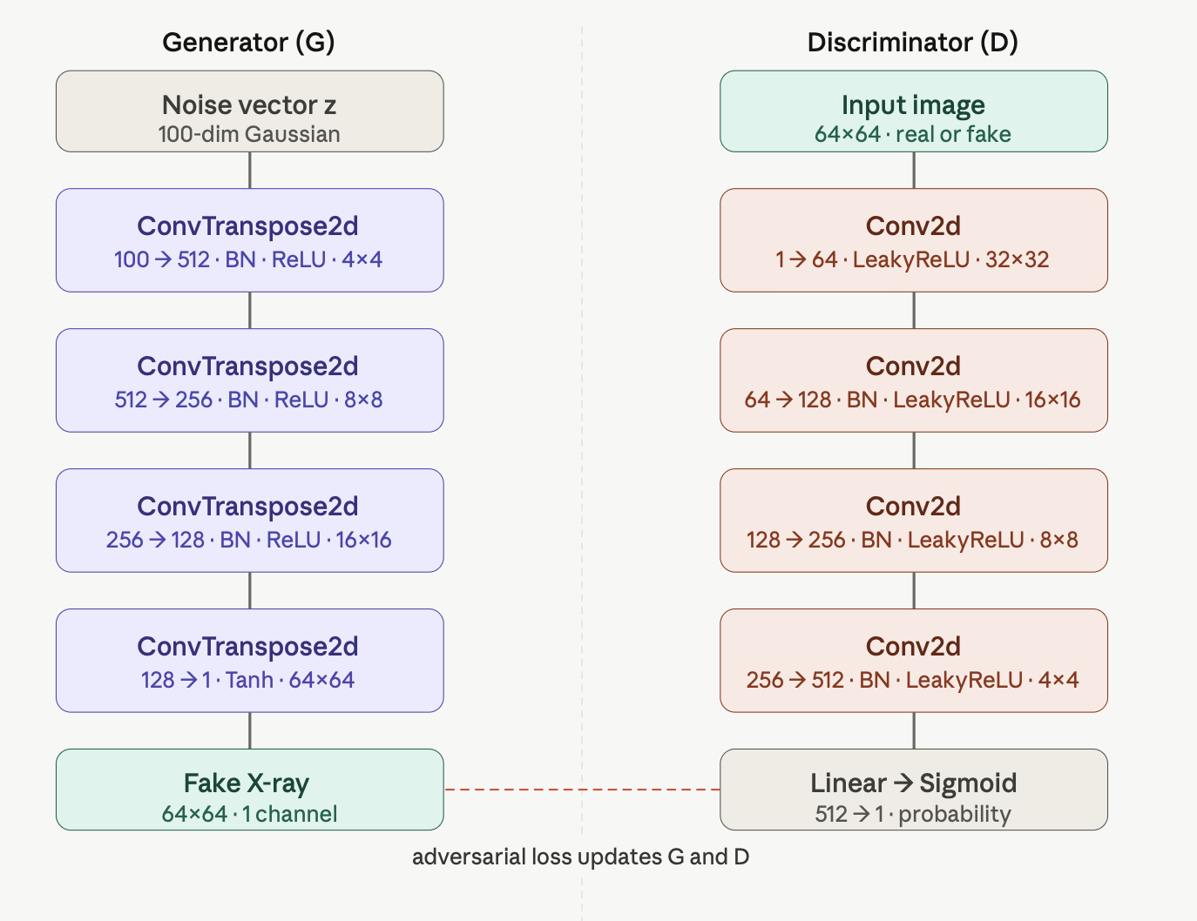
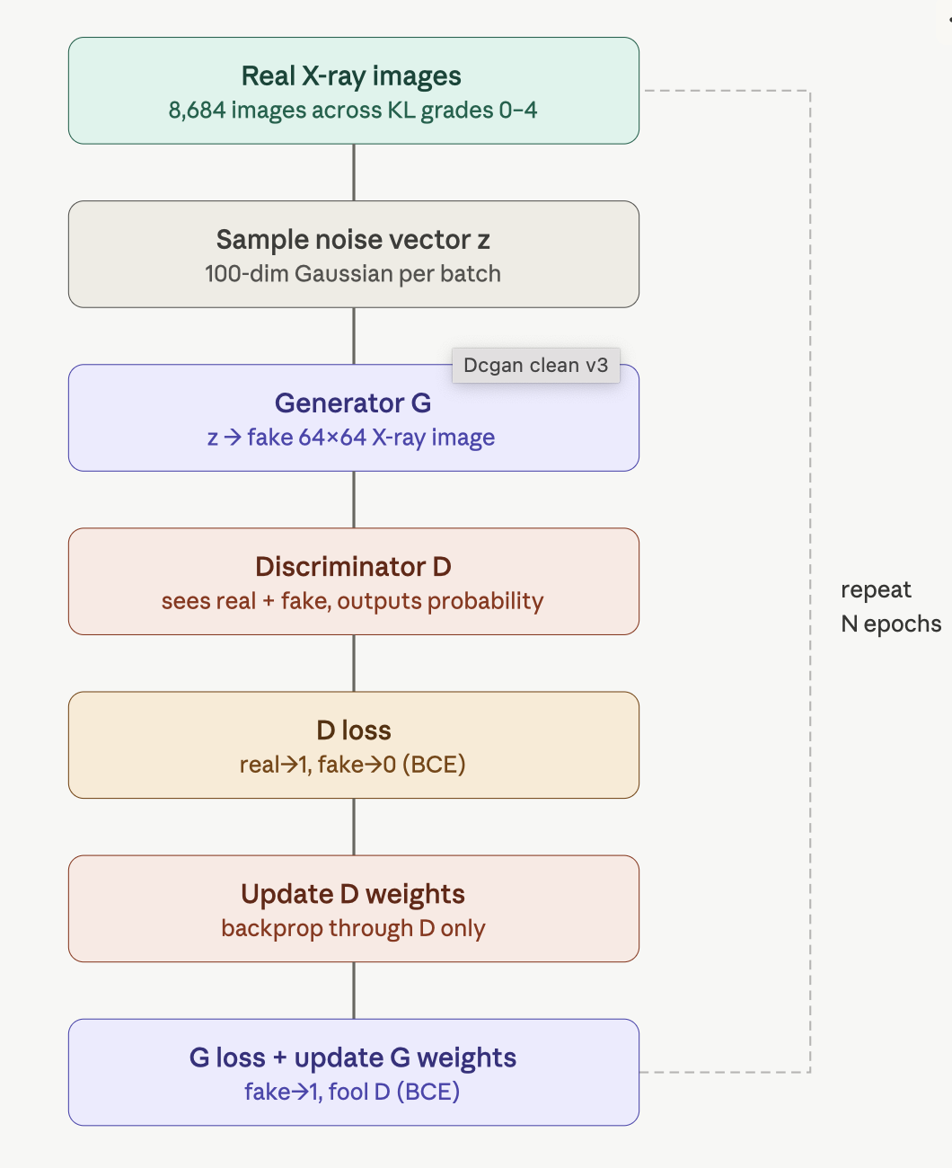
Generating Synthetic Data - DCGAN
DCGAN Architecture
Generation Process

Slide 23
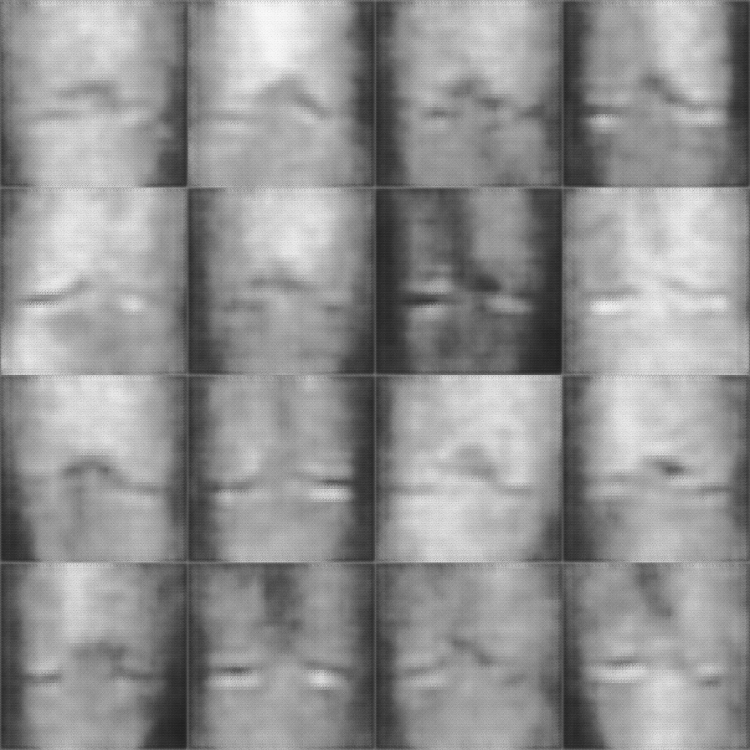
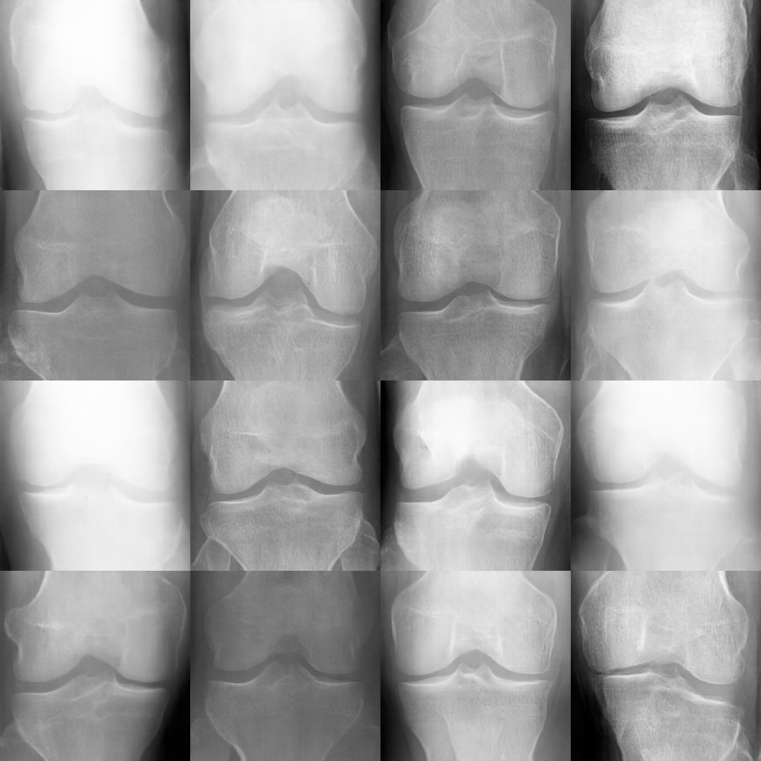
Generating Synthetic Data - DCGAN
Epoch 0
Epoch 200

Slide 24
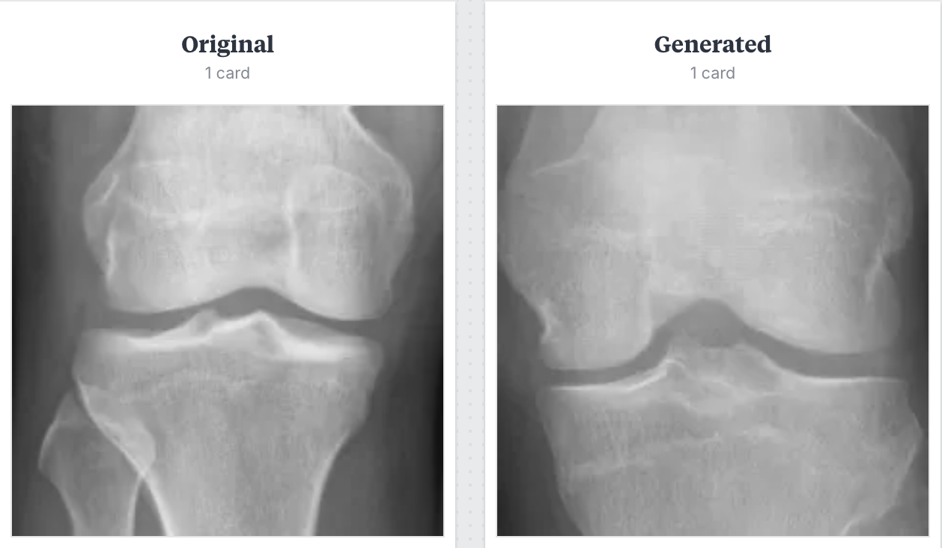
Generating Synthetic Data - DCGAN

Slide 25
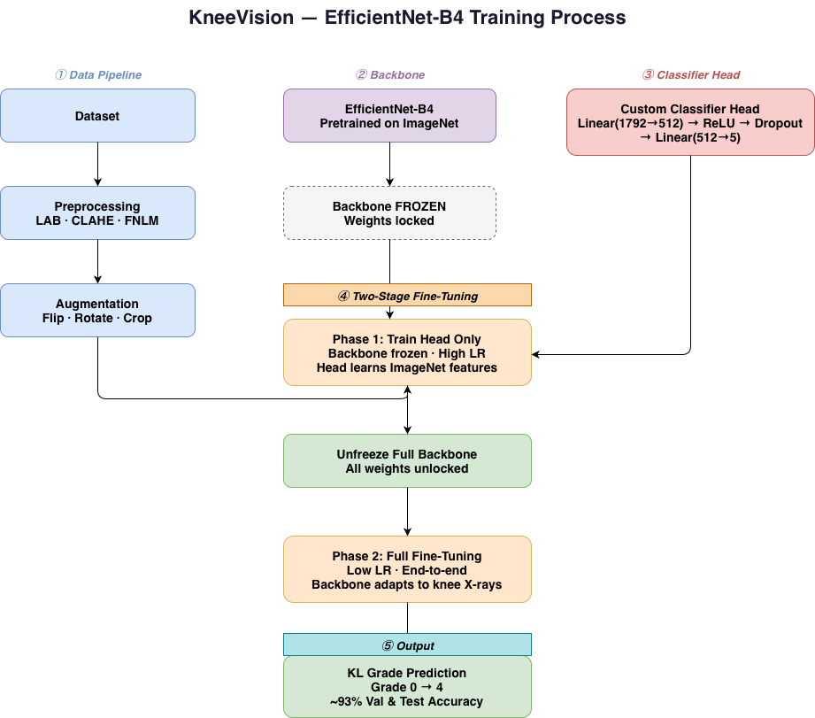
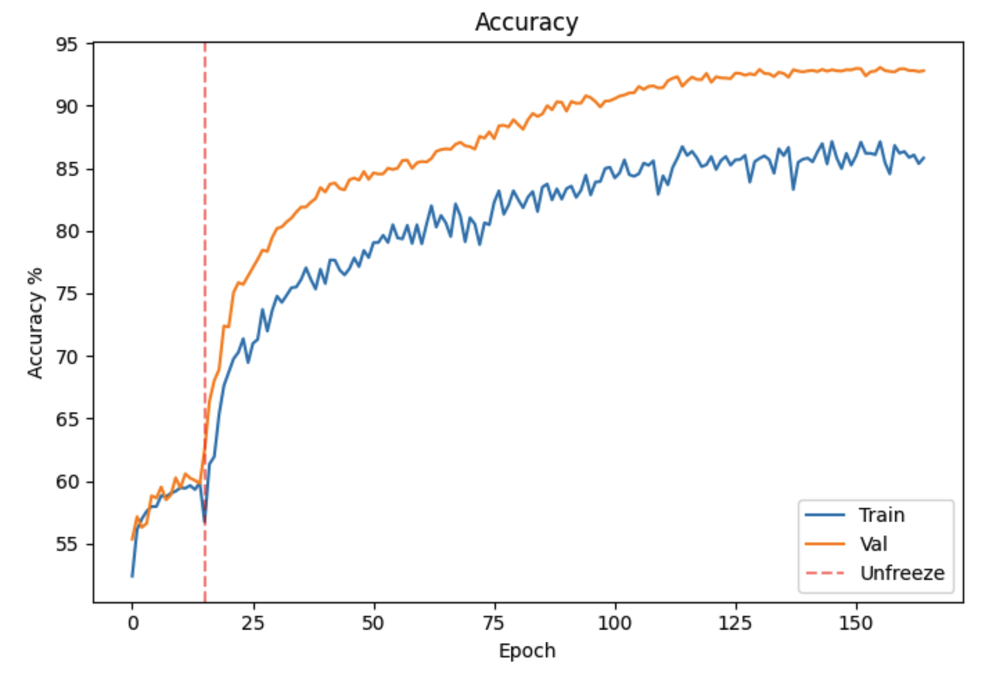
Model Overview

Slide 26
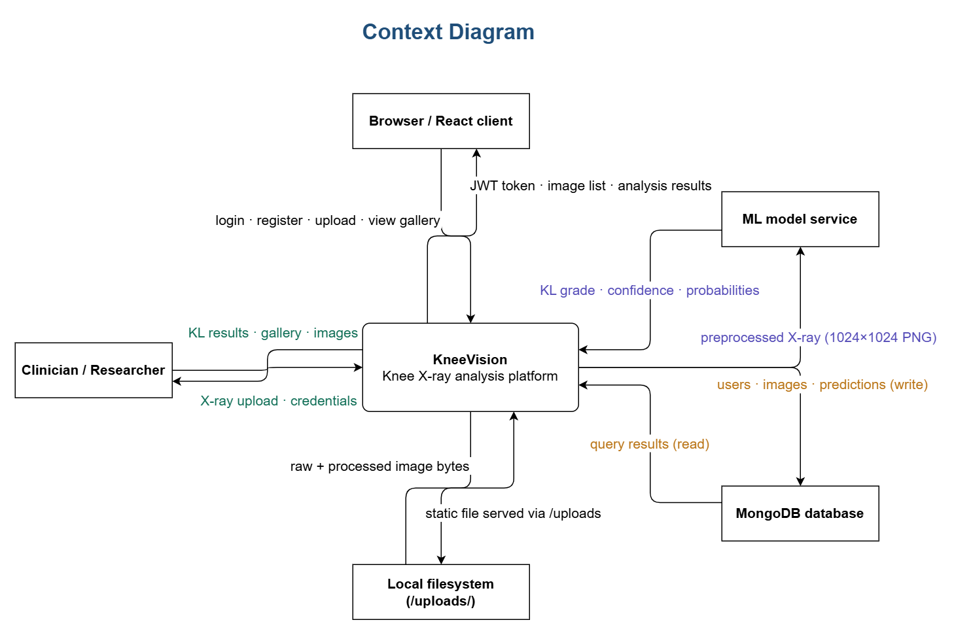
Context Diagram

Slide 27
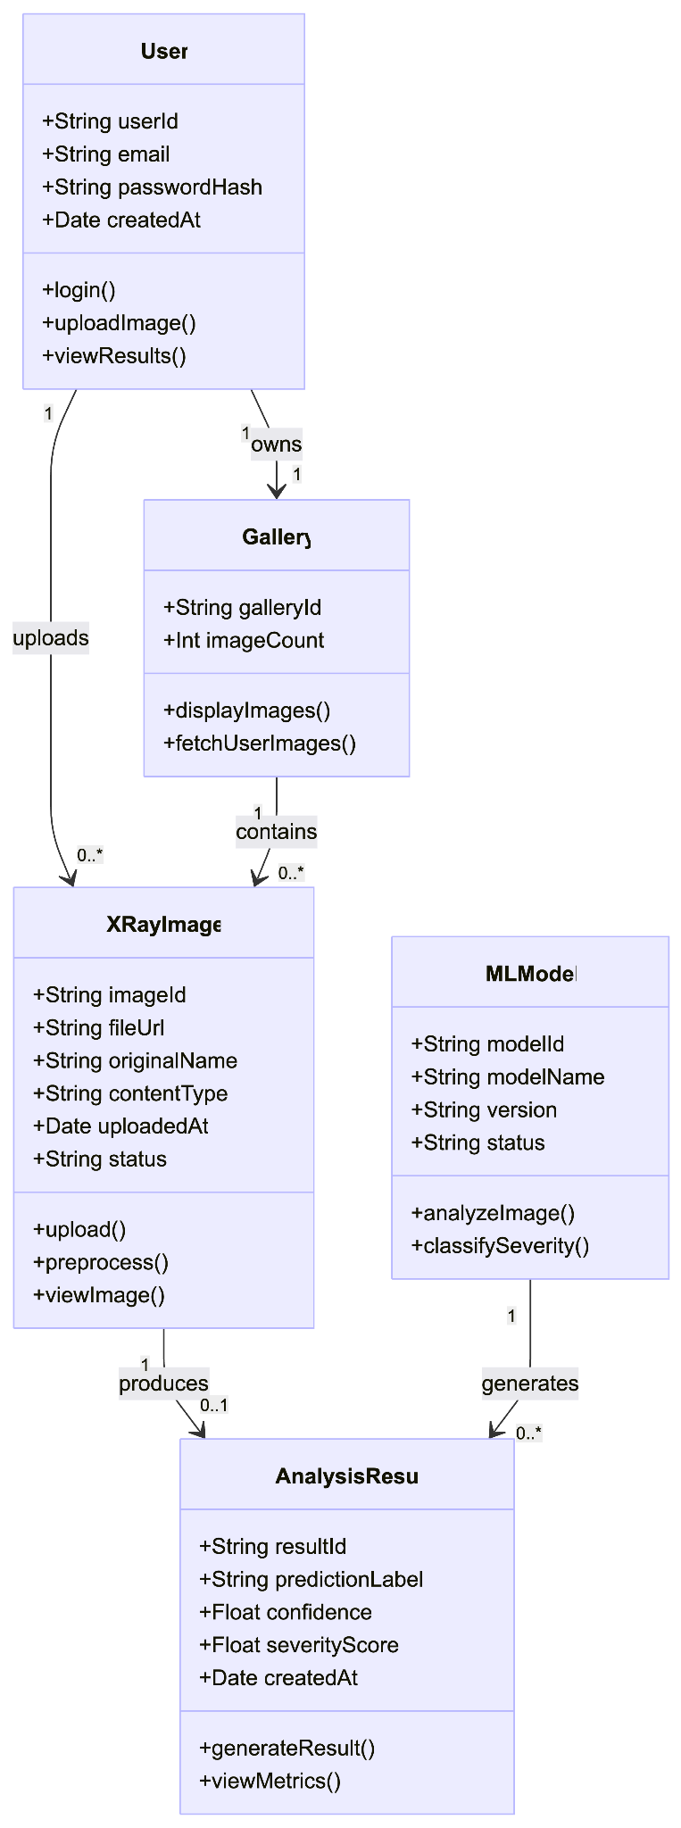
Class Diagram

Slide 28
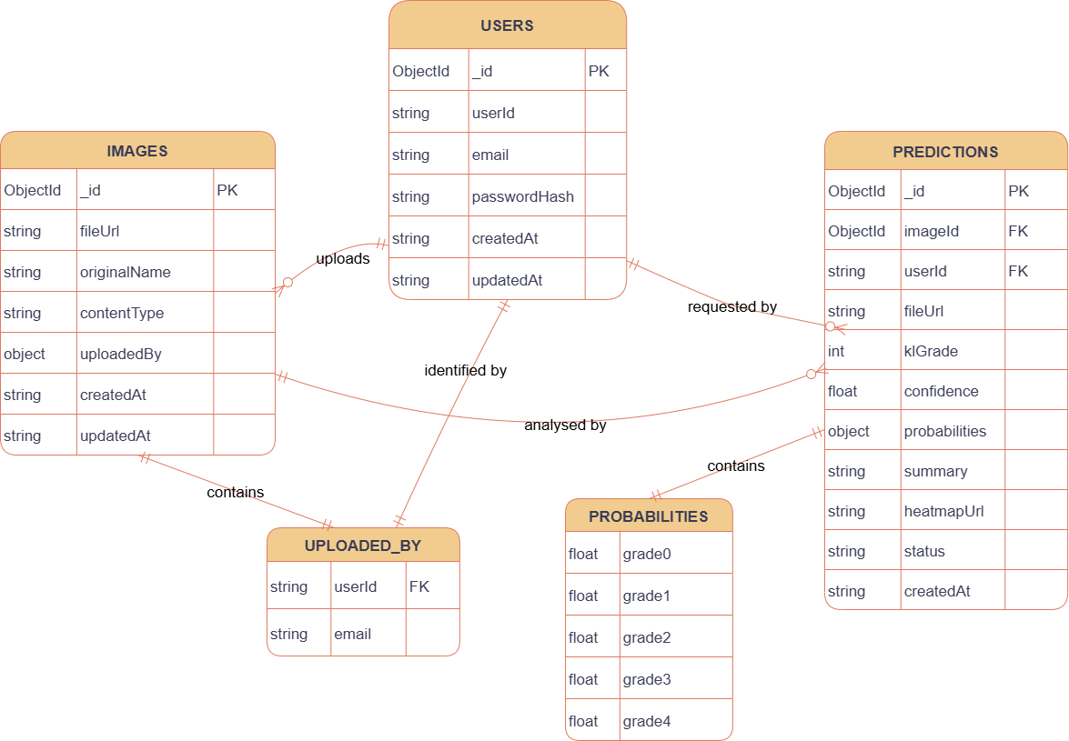
ER Diagram

Slide 29
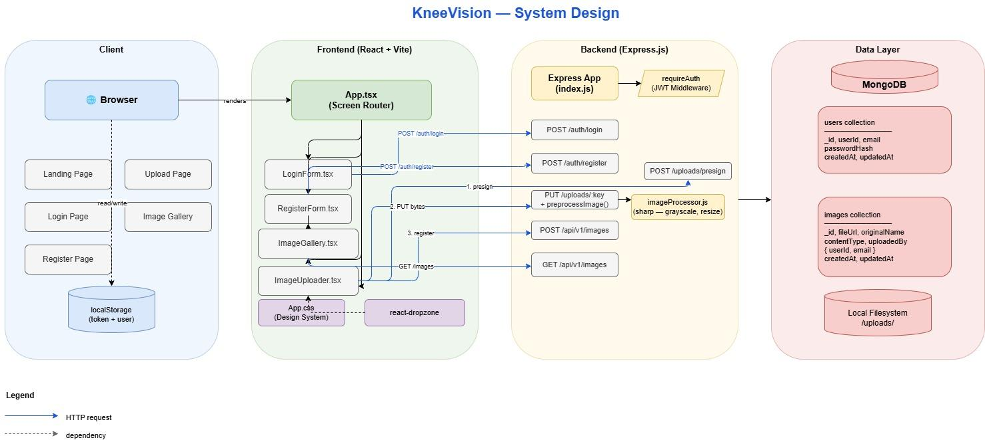
Architecture Diagram

Slide 30
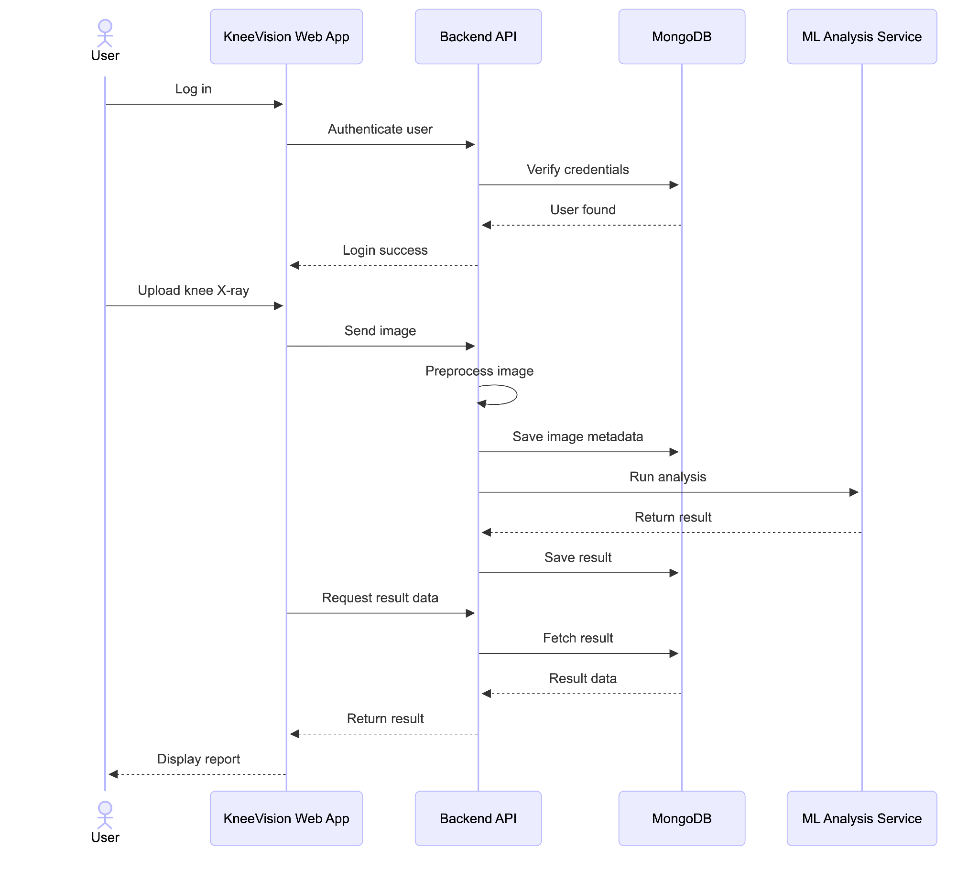
Sequence Diagram

Slide 31
State Diagram

Slide 32
Sprint 1 Recap
Set up full-stack app (React + Vite + Node/Express)
Implemented JWT authentication (login & registration)
Built core UI screens (landing, auth, upload)
Developed image upload + storage pipeline (MongoDB)
Added preprocessing for ML readiness (resize/normalize)
Created gallery view for uploaded images

Slide 33
PRODUCT BACKLOG - USER STORIES
Sprint 1
Sprint 2
Sprint 3
US_ID
User Stories
Acceptance Criteria
Feature
Story Points
US_01
As an individual user, I want to upload knee X-ray images so that I can receive an AI-based assessment of osteoarthritis severity.
The patient can access an interface to upload an image.
The patient can select and submit an image from device.
The system accepts image files in specified formats: JPEG, JPG, PNG, DICOM.
The uploaded image is stored and associated with the patient's case.
A confirmation message is displayed upon successful upload.
Image Upload
13
US_02
As a research coordinator, I want to upload multiple X-ray images at once so that I can analyze datasets efficiently.
The patient can upload multiple images (up to 3) to one case.
The system accepts multiple images in specified formats (JPEG, JPG, PNG).
All uploaded images are associated with the same patient case.
The patient receives a confirmation message after uploading each image.
The system displays a preview of all uploaded images for review before analysis.
Image Upload
8

Slide 34
PRODUCT BACKLOG - USER STORIES
US_ID
User Stories
Acceptance Criteria
Feature
Story Points
US_03
As an individual user, I want to register an account so that I can store my basic information and access personalised services.
The user can access a registration page requiring: Full name, Email address, Password creation.
Post-registration, the user can log in and update their profile information.
User Management
2
US_04
As an individual user, I want to log in to my account so that I can manage my cases and view diagnoses.
The user accesses a login page requiring: Email address, Password.
Upon successful login, the user is directed to their dashboard.
User Management
1
US_05
As a user, I want to view my past cases and track their statuses so that I can monitor my health progress.
The user can access a 'Case History' section after logging in.
All past cases are listed in chronological order (most recent first).
Each case displays: case ID, case open date, status.
The system updates case statuses in real-time.
Clicking on a case entry navigates the user to that case's report.
User Management
2
US_06
As an individual user, I want to implement JWT authentication so that my session is secure.
JWT tokens are generated on login and validated on every protected route.
Tokens expire after a defined period and require re-authentication.
Invalid or expired tokens return a 401 Unauthorized response.
User Management
3

Slide 35
PRODUCT BACKLOG - USER STORIES
US_ID
User Stories
Acceptance Criteria
Feature
Story Points
US_07
As an individual user, I want to receive an OA severity diagnosis so that I know the knee condition I am facing.
After submitting the image, the user receives a diagnosis.
The diagnosis is presented as the KL grade (0–4) and severity label.
The system provides the diagnosis within a reasonable time (< 1 min).
The diagnosis is stored and associated with the user's case.
AI Model Integration
20
US_08
As an individual user, I want to receive the most accurate possible diagnosis so that I can trust the assessment provided.
The system continuously improves the model and algorithms for better diagnostic results.
The diagnosis accuracy is optimised based on model refinements and external validation.
The confidence level of the diagnosis should be high (e.g., 95%).
AI Model Integration
11
US_09
As an individual user, I want to receive a brief description of the diagnosed condition so that I can understand the issue I am facing.
After receiving the diagnosis, the user is provided with a brief description of the diagnosed condition.
The description is written in clear, understandable language.
The description includes common symptoms and causes.
AI Model Integration
2
US_10
As an individual user, I want to receive treatment recommendations so that I can take action towards treating my knee condition.
After receiving the diagnosis, the user is provided with treatment recommendations.
The description is written in clear, understandable language.
The description includes common symptoms and causes of the condition.
AI Model Integration
3

Slide 36
Sprint 2 Backlog
US_ID
User Stories
Acceptance Criteria
Feature
US_02
As a research coordinator, I want to upload multiple X-ray images at once so that I can analyze datasets efficiently.
The patient can upload multiple images (up to 3) to one case.
The system accepts multiple images in specified formats (JPEG, JPG, PNG).
All uploaded images are associated with the same patient case.
The patient receives a confirmation message after uploading each image.
The system displays a preview of all uploaded images for review before analysis.
Image Upload
US_08
As an individual user, I want to receive the most accurate possible diagnosis so that I can trust the assessment provided.
The system continuously improves the model and algorithms for better diagnostic results.
The diagnosis accuracy is optimised based on model refinements and external validation.
The confidence level of the diagnosis should be high (e.g., 95%).
AI Model Integration

Slide 37
Sprint 2 Backlog
US_ID
User Stories
Acceptance Criteria
Feature
US_09
As an individual user, I want to receive a brief description of the diagnosed condition so that I can understand the issue I am facing.
After receiving the diagnosis, the user is provided with a brief description of the diagnosed condition.
The description is written in clear, understandable language.
The description includes common symptoms and causes.
AI Model Integration
US_10
As an individual user, I want to receive treatment recommendations so that I can take action towards treating my knee condition.
After receiving the diagnosis, the user is provided with treatment recommendations.
The description is written in clear, understandable language.
The description includes common symptoms and causes of the condition.
AI Model Integration

Slide 38
Project Schedule - Sprint 2
Key | Issue Type | Parent | Summary | Status | Assignee | Sprint
SCRUM-91 | Story | SCRUM-78 | As an individual user, I want to use the platform on my phone so that I can access it from anywhere | Done |  | Sprint 2
SCRUM-53 | Task | SCRUM-79 | Technical paper - Implementation section | Done | Deep | Sprint 2
SCRUM-50 | Task | SCRUM-79 | Integration testing (upload -> predict -> display) | Done | Siming Li | Sprint 2
SCRUM-37 | Task | SCRUM-79 | Train model on Google Colab | Done | Deep | Sprint 2
SCRUM-38 | Task | SCRUM-79 | Evaluate model (target 75%+ accuracy) | Done | Deep | Sprint 2
SCRUM-39 | Task | SCRUM-79 | Save trained model (.pt format) | Done | Deep | Sprint 2
SCRUM-45 | Task | SCRUM-79 | Build results display page | Done | Daniel Fox | Sprint 2
SCRUM-92 | Task | SCRUM-79 | Create and train model for converting xray to unet images | Done | Sarvesh Shah | Sprint 2
SCRUM-93 | Task | SCRUM-79 | Feature extraction from unet images for training model | Done | Sarvesh Shah | Sprint 2
SCRUM-46 | Task | SCRUM-79 | Build results display page 1 | Done | Siming Li | Sprint 2
SCRUM-44 | Task | SCRUM-79 | Store prediction results in database | Done | Manohar | Sprint 2
SCRUM-40 | Task | SCRUM-79 | Create predictions table in database | Done | Manohar | Sprint 2
SCRUM-54 | Task | SCRUM-79 | Create system architecture diagram | Done | Manohar | Sprint 2
SCRUM-34 | Task | SCRUM-79 | Update API documentation (Swagger) | Done | Manohar | Sprint 2
Notes:
SL start

Slide 39
Project Schedule - Sprint 2
Key | Issue Type | Parent | Summary | Status | Assignee | Sprint
SCRUM-41 | Task | SCRUM-79 | Build model serving endpoint | Done | Swatej Goud Mella | Sprint 2
SCRUM-42 | Task | SCRUM-79 | Build /predict API endpoint | Done | Swatej Goud Mella | Sprint 2
SCRUM-48 | Task | SCRUM-79 | Create KL grade explanation modal | Done | Swatej Goud Mella | Sprint 2
SCRUM-49 | Task | SCRUM-79 | Add probability distribution visualization | Done | Swatej Goud Mella | Sprint 2
SCRUM-52 | Task | SCRUM-79 | Technical paper - Methodology section | Done | Deep | Sprint 2
SCRUM-63 | Task | SCRUM-80 | Cross-browser testing (Chrome, Firefox, Safari) | Done | Siming Li | Sprint 2
SCRUM-56 | Task | SCRUM-80 | Build analysis history page | Done | Daniel Fox | Sprint 2
SCRUM-57 | Task | SCRUM-80 | Add filter and sort functionality | Done | Siming Li | Sprint 2
SCRUM-55 | Task | SCRUM-80 | Document model training process | Done | Sarvesh Shah | Sprint 2
Notes:
SL start

Slide 40
Project Schedule - Sprint 2 (Spill Over)
Key | Issue Type | Parent | Summary | Status | Assignee | Sprint
SCRUM-59 | Task | SCRUM-80 | Add educational tooltips throughout app | To Do | Swatej Goud Mella | Sprint 2
SCRUM-60 | Task | SCRUM-80 | Make UI responsive (mobile/tablet/desktop) | To Do | Daniel Fox | Sprint 2
Notes:
SL start

Slide 41
Product Backlog - Outstanding
ID | Summary | Epic | Status | Priority
SCRUM-59 | Add educational tooltips throughout app | MVP Completion & Deployment | TO DO | Low
SCRUM-60 | Make UI responsive (mobile/tablet/desktop) | MVP Completion & Deployment | TO DO | High
SCRUM-33 | Deploy to development environment | User Management & Image Upload | TO DO | Medium
SCRUM-43 | Test prediction API (< 7 sec response) | AI Model Integration | TO DO | Medium
SCRUM-47 | Show confidence score with progress bar | AI Model Integration | TO DO | Medium
SCRUM-61 | Add error logging (backend + frontend) | MVP Completion & Deployment | TO DO | Medium
SCRUM-62 | Conduct UAT with 3-5 external testers | MVP Completion & Deployment | TO DO | Medium
SCRUM-64 | Performance testing (150 concurrent users) | MVP Completion & Deployment | TO DO | Medium
SCRUM-65 | Security audit (OWASP top 10) | MVP Completion & Deployment | TO DO | Medium
SCRUM-66 | Fix all critical and high-priority bugs | MVP Completion & Deployment | TO DO | Medium
SCRUM-67 | Deploy frontend to Vercel/Netlify | MVP Completion & Deployment | TO DO | Medium
SCRUM-68 | Deploy backend to Render/Railway | MVP Completion & Deployment | TO DO | Medium
Notes:
SL ends

Slide 42
Product Backlog - Outstanding
ID | Summary | Epic | Status | Priority
SCRUM-69 | Deploy ML model endpoint | MVP Completion & Deployment | TO DO | Medium
SCRUM-70 | Set up monitoring and error tracking | MVP Completion & Deployment | TO DO | Medium
SCRUM-71 | Final end-to-end testing in production | MVP Completion & Deployment | TO DO | Medium
SCRUM-72 | Create privacy policy page | MVP Completion & Deployment | TO DO | Medium
SCRUM-73 | Finalize technical paper (incorporate feedback) | MVP Completion & Deployment | TO DO | Medium
SCRUM-74 | Write deployment manual (step-by-step) | MVP Completion & Deployment | TO DO | Medium
SCRUM-75 | Write user manual with screenshots | MVP Completion & Deployment | TO DO | Medium
SCRUM-76 | Record final MVP demo video (5-10 min) | MVP Completion & Deployment | TO DO | Medium
SCRUM-77 | Prepare final presentation slides | MVP Completion & Deployment | TO DO | Medium
SCRUM-87 | As a research coordinator, I want to export prediction results so that I can use them in research analysis | AI Model Integration | TO DO | Medium
SCRUM-88 | As a learner, I want to see visual cues related to severity so that I can connect imaging features to outcomes | AI Model Integration | TO DO | Medium
Notes:
SL ends

Slide 43
Test Cases
Test Summary
Module | Total | Passed | Failed | Coverage
Backend — imageProcessor.js | 11 | 11 | 0 | ~95%
Backend — db.js | 6 | 6 | 0 | ~90%
Backend — API routes (index.js) | 52 | 52 | 0 | ~90%
Frontend — LoginForm | 10 | 10 | 0 | ~92%
Frontend — RegisterForm | 10 | 10 | 0 | ~91%
Frontend — ImageGallery | 8 | 8 | 0 | ~90%
Frontend — ImageUploader | 8 | 8 | 0 | ~85%
Frontend — Pages | 16 | 16 | 0 | ~88%
TOTAL | 121 | 121 | 0 | ~89%
Stack==> Node.js | Express | MongoDB | React | TypeScript | Jest | Vitest

Slide 44
Test Cases - Backend
Test Case | Test Name | Test Steps | Description / Expected Result | Status
1 | Returns a Buffer | 1. Create a 100×100 RGB PNG buffer using sharp. 2. Call preprocessImage(buffer). 3. Inspect the returned value. | preprocessImage() output is a Buffer instance | ✓ PASS
2 | Outputs PNG by default | 1. Call preprocessImage(buffer) with no format option. 2. Inspect output metadata using sharp(result).metadata(). | Default format produces image/png metadata | ✓ PASS
3 | Converts image to grayscale | 1. Create a colour PNG buffer. 2. Call preprocessImage(buffer). 3. Read output metadata with sharp. | Output has 1 channel (grayscale) | ✓ PASS
4 | No upscale for small images | 1. Call preprocessImage(buffer, { width: 1024, height: 1024 }). 2. Read output metadata. | 50x50 image stays ≤50px when target is 1024x1024 | ✓ PASS
5 | Resizes large image to fit target | 1. Call preprocessImage(buffer, { width: 512, height: 512 }). 2. Read output metadata. | 2000x2000 image resized to ≤512x512 when target is 512 | ✓ PASS
6 | Preserves aspect ratio | 1. Call preprocessImage(buffer, { width: 200, height: 200 }). 2. Compute width/height ratio of output. | 200x100 (2:1) input produces ~2:1 ratio output | ✓ PASS
7 | Outputs JPEG when format=jpeg | 1. Call preprocessImage(buffer, { format: 'jpeg' }). 2. Read output metadata. | format:'jpeg' option produces jpeg metadata | ✓ PASS
8 | Outputs WebP when format=webp | 1. Call preprocessImage(buffer, { format: 'webp' }). 2. Read output metadata. | format:'webp' option produces webp metadata | ✓ PASS
9 | Normalize option does not throw | 1. Call preprocessImage(buffer, { normalize: true }). 2. Await the result. | normalize:true runs without error | ✓ PASS
10 | Throws on invalid buffer | 1. Create Buffer.from('not-an-image'). 2. Call preprocessImage(badBuffer). 3. Await and expect rejection. | Non-image buffer rejects with 'Image preprocessing failed' | ✓ PASS
11 | Throws on null input | 1. Call preprocessImage(null). 2. Await and expect rejection. | null input causes rejection | ✓ PASS
12 | Throws when MONGODB_URI missing | 1. Delete process.env.MONGODB_URI. 2. Call connectToMongo(). 3. Await the promise. | connectToMongo() rejects with 'MONGODB_URI is not set' | ✓ PASS
13 | Connects and returns db instance | 1. Set process.env.MONGODB_URI to a valid URI. 2. Call connectToMongo(). 3. Inspect return value. | Valid URI resolves to a db object | ✓ PASS
14 | Creates unique index on users.email | 1. Call connectToMongo(). 2. Check that db.collection('users').createIndex was called. | createIndex called with {email:1}, {unique:true} | ✓ PASS
15 | Caches db on repeated calls | 1. Call connectToMongo() twice. 2. Check client.connect call count. | client.connect called exactly once after two connectToMongo() calls | ✓ PASS

Slide 45
Test Cases - Backend
Test Case | Test Name | Test Steps | Description / Expected Result | Status
16 | getDb throws before connect | 1. Import getDb from fresh module. 2. Call getDb() immediately. | getDb() throws 'MongoDB not connected' before connectToMongo() | ✓ PASS
17 | getDb returns db after connect | 1. Call connectToMongo(). 2. Call getDb(). 3. Inspect return value. | getDb() returns db object after successful connect | ✓ PASS
18 | GET /health returns 200 | 1. Send GET request to /health. | Response body is {status:'ok'} | ✓ PASS
19 | Register — valid input returns 201 | 1. POST /api/v1/auth/register with { email: 'test@example.com', password: 'password123' }. 2. Inspect response. | Returns id, email, createdAt on valid body | ✓ PASS
20 | Register — missing email → 400 | 1. POST /api/v1/auth/register with { password: 'password123' } only. | Returns 400 with 'required' message | ✓ PASS
21 | Register — missing password → 400 | 1. POST /api/v1/auth/register with { email: 'test@example.com' } only. | Returns 400 | ✓ PASS
22 | Register — invalid email → 400 | 1. POST /api/v1/auth/register with { email: 'not-an-email', password: 'password123' }. | Returns 400 with 'Invalid email format' | ✓ PASS
23 | Register — short password → 400 | 1. POST /api/v1/auth/register with { email: 'test@example.com', password: 'short' }. | Returns 400 with '8 characters' message | ✓ PASS
24 | Register — duplicate user → 409 | 1. POST /api/v1/auth/register with existing email. | Returns 409 with 'User already exists' | ✓ PASS
25 | Register — email normalized | 1. POST with { email: 'USER@EXAMPLE.COM', password: 'password123' }. 2. Check response body email field. | USER@EXAMPLE.COM stored as user@example.com | ✓ PASS
26 | Login — valid credentials → 200 | 1. POST /api/v1/auth/login with correct email and password. | Returns JWT token and user object | ✓ PASS
27 | Login — empty body → 400 | 1. POST /api/v1/auth/login with empty body {}. | Returns 400 | ✓ PASS
28 | Login — unknown user → 401 | 1. POST /api/v1/auth/login with unregistered email. | Returns 401 with 'Invalid email or password' | ✓ PASS
29 | Login — wrong password → 401 | 1. POST /api/v1/auth/login with correct email but wrong password. | Returns 401 | ✓ PASS
30 | Presign — valid input → 200 | 1. POST /api/v1/uploads/presign with { filename: 'xray.png', contentType: 'image/png' }. | Returns uploadUrl, fileUrl, method:PUT | ✓ PASS

Slide 46
Test Cases - Backend
Test Case | Test Name | Test Steps | Description / Expected Result | Status
31 | Presign — missing filename → 400 | 1. POST /api/v1/uploads/presign with { contentType: 'image/png' } only. | Returns 400 | ✓ PASS
32 | Presign — missing contentType → 400 | 1. POST /api/v1/uploads/presign with { filename: 'xray.png' } only. | Returns 400 | ✓ PASS
33 | Images — valid input → 201 | 1. POST /api/v1/images with { fileUrl: '/uploads/test.png', originalName: 'xray.png', contentType: 'image/png' }. | Returns id, fileUrl, originalName, contentType | ✓ PASS
34 | Images — missing fileUrl → 400 | 1. POST /api/v1/images with { originalName: 'xray.png' } only. | Returns 400 with 'fileUrl is required' | ✓ PASS
35 | GET /images — no token → 401 | 1. Send GET /api/v1/images with no Authorization header. | Returns 401 with 'Authorization token is required' | ✓ PASS
36 | GET /images — malformed token → 401 | 1. Send GET /api/v1/images with Authorization: Bearer not.a.real.token. | Returns 401 with 'Invalid or expired token' | ✓ PASS
37 | GET /images — empty gallery → 200 [] | 1. mockFind returns []. 2. Send GET /api/v1/images with valid Bearer token. | Returns 200 with empty array [] | ✓ PASS
38 | GET /images — returns images mapped correctly | 1. mockFind returns 2 fake image docs. 2. Send GET /api/v1/images with valid Bearer token. | Returns 200, body length 2, first item has id 'img001' and fileUrl '/uploads/scan.png' | ✓ PASS
39 | GET /images — DB error → 500 | 1. mockFind rejects with Error('DB error'). 2. Send GET /api/v1/images with valid Bearer token. | Returns 500 with 'Failed to fetch images' | ✓ PASS
40 | POST /predict — no token → 401 | 1. POST /api/v1/predict with body { fileUrl: '/uploads/scan.png' } and no token. | Returns 401 | ✓ PASS
41 | POST /predict — missing fileUrl → 400 | 1. POST /api/v1/predict with valid token and empty body {}. | Returns 400 with 'fileUrl is required' | ✓ PASS
42 | POST /predict — invalid fileUrl prefix → 400 | 1. POST /api/v1/predict with { fileUrl: '/etc/passwd' }. | Returns 400 with 'Invalid fileUrl' | ✓ PASS
43 | POST /predict — file not on disk → 404 | 1. mockFsAccess rejects (ENOENT). 2. POST /api/v1/predict with { fileUrl: '/uploads/scan.png' }. | Returns 404 with 'Uploaded file not found' | ✓ PASS
44 | POST /predict — image not in DB → 404 | 1. mockFsAccess resolves. mockCallMlPredict resolves. mockFindOne returns null. 2. POST /api/v1/predict. | Returns 404 with 'Image not found' | ✓ PASS
45 | POST /predict — returns cached prediction | 1. mockFindOne returns imageDoc then existing prediction. 2. POST /api/v1/predict. 3. Check mockInsertOne was not called. | Returns 200, id='pred999', klGrade=1. mockInsertOne called 0 times | ✓ PASS

Slide 47
Test Cases - Backend
Test Case | Test Name | Test Steps | Description / Expected Result | Status
46 | POST /predict — saves new prediction and returns ML result | 1. mockFindOne returns imageDoc then null. 2. mockCallMlPredict returns {klGrade:2, confidence:0.87, label:'Moderate'}. 3. mockInsertOne returns insertedId 'pred001'. 4. POST /api/v1/predict. | Returns 200 with {id:'pred001', imageId:'img001', klGrade:2, confidence:0.87}. mockInsertOne called once | ✓ PASS
47 | POST /predict — ML service error → 500 | 1. mockFsAccess resolves. 2. mockCallMlPredict throws Error('ML service down'). 3. POST /api/v1/predict. | Returns 500 with 'Prediction failed' | ✓ PASS
48 | GET /predictions — no token → 401 | 1. Send GET /api/v1/predictions with no Authorization header. | Returns 401 | ✓ PASS
49 | GET /predictions — invalid token → 401 | 1. Send GET /api/v1/predictions with Authorization: Bearer invalid.token.here. | Returns 401 | ✓ PASS
50 | GET /predictions — empty list → 200 [] | 1. mockFind returns []. 2. Send GET /api/v1/predictions with valid Bearer token. | Returns 200 with empty array [] | ✓ PASS
51 | GET /predictions — returns predictions mapped correctly | 1. mockFind returns 2 fake prediction docs. 2. Send GET /api/v1/predictions with valid Bearer token. | Returns 200, body length 2. First item: id='pred001', result.klGrade=2. Second item: result.klGrade=0 | ✓ PASS
52 | GET /predictions — DB error → 500 | 1. mockFind rejects with Error('DB connection lost'). 2. Send GET /api/v1/predictions with valid Bearer token. | Returns 500 with 'Failed to fetch predictions' | ✓ PASS

Slide 48
Test Cases - Frontend
Test Case | Test Name | Test Steps | Description / Expected Result | Status
1 | Renders all form fields | 1. Render <LoginForm onLoginSuccess={fn} />. 2. Query for email input, password input, Login button. | Email, password inputs and Login button present | ✓ PASS
2 | Empty email shows error | 1. Click the Login button without filling any field. | Submitting with no email shows 'Email is required' | ✓ PASS
3 | Empty password shows error | 1. Type a valid email. 2. Click Login without filling password. | Submitting with no password shows 'Password is required' | ✓ PASS
4 | No fetch on validation failure | 1. Click Login with empty fields. | fetch() not called when form is invalid | ✓ PASS
5 | Fetch called with correct payload | 1. Type 'User@Example.COM' in email field. 2. Type 'password123' in password field. 3. Click Login. | Email lowercased, sent to /api/v1/auth/login | ✓ PASS
6 | Token stored in localStorage | 1. Submit valid credentials. 2. Check localStorage after submission. | localStorage.getItem('token') equals returned JWT | ✓ PASS
7 | onLoginSuccess called on success | 1. Submit valid credentials. 2. Wait for async resolution. | Callback fires once after successful login | ✓ PASS
8 | Server error shown | 1. Submit credentials. 2. Wait for response. | 'Invalid email or password' shown on 401 response | ✓ PASS
9 | Network error shown | 1. Submit valid credentials. | 'Network Error' shown when fetch throws | ✓ PASS
10 | Button disabled while loading | 1. Submit valid credentials. 2. Immediately inspect button state. | Submit button is disabled while fetch is pending | ✓ PASS
11 | Renders all form fields | 1. Render <RegisterForm onRegistrationSuccess={fn} />. 2. Query for email, password, confirm password, Register button. | Email, password, confirm password, Register button present | ✓ PASS
12 | Empty email shows error | 1. Click Register without filling any field. | 'Email is required' shown on empty submit | ✓ PASS
13 | Short password shows error | 1. Type email. 2. Type password shorter than 8 characters. 3. Click Register. | 'at least 8 characters' shown for short password | ✓ PASS
14 | Password mismatch shows error | 1. Fill email and password. 2. Type different value in confirm password. 3. Click Register. | 'Passwords do not match' shown when fields differ | ✓ PASS
15 | No fetch on validation failure | 1. Click Register with empty form. | fetch() not called when form is invalid | ✓ PASS

Slide 49
Test Cases - Frontend
Test Case | Test Name | Test Steps | Description / Expected Result | Status
16 | Fetch called with correct payload | 1. Fill 'User@Example.COM', 'password123', 'password123'. 2. Click Register. | Email lowercased, sent to /api/v1/auth/register | ✓ PASS
17 | Success message and redirect | 1. Submit valid form. 2. Advance timers by 800ms. | 'Registration successful' shown; onRegistrationSuccess fires after 800ms | ✓ PASS
18 | Form cleared on success | 1. Submit valid form. 2. Wait for success state. | All fields empty after successful registration | ✓ PASS
19 | Server error shown | 1. Submit valid form. | 'User already exists' shown on 409 response | ✓ PASS
20 | Button disabled while submitting | 1. Submit valid form. 2. Inspect button state. | Register button disabled while fetch pending | ✓ PASS
21 | Empty state message shown | 1. Render <ImageGallery images={[]} />. | 'No images to display' shown for empty array | ✓ PASS
22 | Empty state for undefined prop | 1. Render <ImageGallery images={undefined} />. | 'No images to display' shown when images is undefined | ✓ PASS
23 | Renders img per image | 1. Render <ImageGallery images={[img1, img2]} />. 2. Query all <img> elements. | One <img> element rendered per image with url | ✓ PASS
24 | title used as alt text | 1. Render gallery with image { url: '...', title: 'Knee X-ray' }. | img alt equals image.title | ✓ PASS
25 | Falls back to originalName | 1. Render gallery with image { url: '...', originalName: 'scan.png' }. | img alt equals originalName when title absent | ✓ PASS
26 | Falls back to fileUrl | 1. Render gallery with image { fileUrl: '/uploads/scan.png', title: 'Scan' }. | img src equals fileUrl when url absent | ✓ PASS
27 | No preview placeholder | 1. Render gallery with image { id: '1', title: 'Mystery' }. | 'No preview' shown when url and fileUrl both absent | ✓ PASS
28 | Label text rendered below image | 1. Render gallery with image { url: '...', title: 'Knee Scan' }. | Title/name text visible below the image | ✓ PASS
29 | Renders dropzone text | 1. Render <ImageUploader />. | 'Drag & drop or click' text visible | ✓ PASS
30 | Shows drag-active text | 1. Fire dragOver event on the dropzone element. | 'Drop files here' shown on dragenter | ✓ PASS

Slide 50
Test Cases - Frontend
Test Case | Test Name | Test Steps | Description / Expected Result | Status
31 | No upload button initially | 1. Render <ImageUploader /> without dropping files. | Upload button absent before files are dropped | ✓ PASS
32 | Upload button after drop | 1. Fire drop event with a PNG file. 2. Query for Upload button. | Upload button appears after files are dropped | ✓ PASS
33 | DICOM placeholder shown | 1. Fire drop event with a .dcm file. 2. Query for DICOM label. | 'DICOM' placeholder shown for .dcm files | ✓ PASS
34 | Full upload flow succeeds | 1. Drop a PNG file. 2. Click Upload. 3. Wait for all three fetch calls. | presign → PUT → register called in order; onUploadSuccess fires | ✓ PASS
35 | Alert on presign failure | 1. Drop a file. 2. Click Upload. | window.alert called when presign returns non-ok | ✓ PASS
36 | Button disabled while uploading | 1. Drop a file. 2. Click Upload. 3. Inspect button state. | Upload button disabled while fetch is pending | ✓ PASS
37 | LoginPage — brand heading | 1. Render <LoginPage onLoginSuccess={fn} onSwitchToRegister={fn} />. | 'KneeVision' h1 rendered | ✓ PASS
38 | LoginPage — subtitle | 1. Render LoginPage. | 'Sign in to your account' text present | ✓ PASS
39 | LoginPage — form rendered | 1. Render LoginPage. | Email and password inputs present inside page | ✓ PASS
40 | LoginPage — switch to register | 1. Click the Register button. | onSwitchToRegister called when Register button clicked | ✓ PASS
41 | RegisterPage — brand heading | 1. Render <RegisterPage onRegistrationSuccess={fn} onSwitchToLogin={fn} />. | 'KneeVision' h1 rendered | ✓ PASS
42 | RegisterPage — subtitle | 1. Render RegisterPage. | 'Create your account' text present | ✓ PASS
43 | RegisterPage — form rendered | 1. Render RegisterPage. | Email and confirm password inputs present inside page | ✓ PASS
44 | RegisterPage — switch to login | 1. Click the Login button. | onSwitchToLogin called when Login button clicked | ✓ PASS
45 | UploadPage — brand heading | 1. Render <UploadPage onLogout={fn} />. | 'KneeVision' h1 rendered | ✓ PASS

Slide 51
Test Cases - Frontend
Test Case | Test Name | Test Steps | Description / Expected Result | Status
46 | UploadPage — subtitle | 1. Render UploadPage. | 'Upload and review knee X-ray' text present | ✓ PASS
47 | UploadPage — logout button | 1. Render UploadPage. | Logout button visible | ✓ PASS
48 | UploadPage — logout callback | 1. Click the Logout button. | onLogout called when Logout clicked | ✓ PASS
49 | UploadPage — gallery heading | 1. Render UploadPage. | 'Gallery' heading present | ✓ PASS
50 | UploadPage — empty state | 1. Render UploadPage with no images. | 'No images to display yet' shown initially | ✓ PASS
51 | UploadPage — add mock image | 1. Click 'Add Mock Image'. 2. Query for img element. | Mock image appears in gallery after clicking 'Add Mock Image' | ✓ PASS
52 | UploadPage — empty state hidden | 1. Click 'Add Mock Image'. 2. Query for empty state text. | Empty state message gone after image added | ✓ PASS

Slide 52
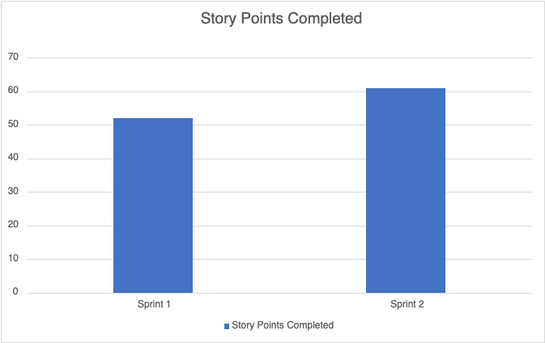
Metrics - Team Velocity
Sprint 2 Story Points Completed: 61

Slide 53
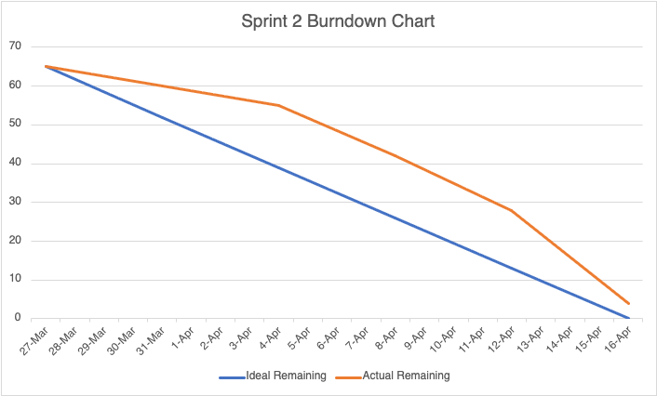
Metrics - Burndown Chart
Sprint 2 Story Points Remaining: 4

Slide 54
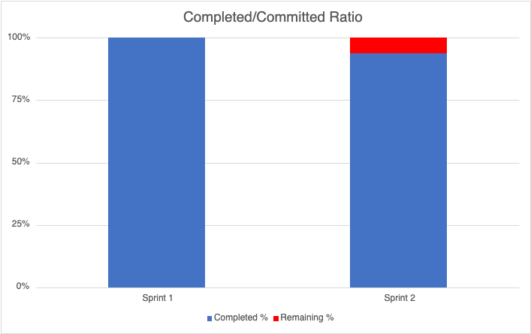
Metrics - Completed/Committed Ratio
Sprint 2 Story Points Completed: 61/65 (93.85%)

Slide 55
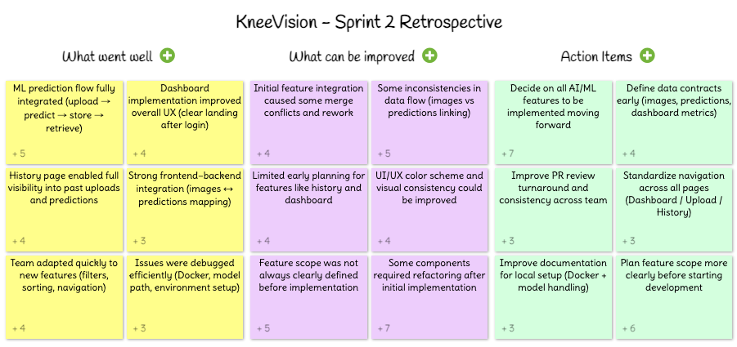
Sprint 2 Retrospective

Slide 56

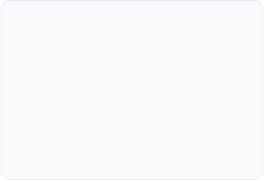
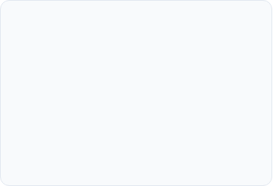



Sprint 2 Retrospective: Important Points
What Went Well
Improvements
Action Items
ML prediction flow fully integrated
Dashboard implementation improved overall UX
History page enabled full visibility into past uploads and predictions
Team adapted quickly to new features
Some inconsistencies in data flow
Feature scope was not always clearly defined before implementation
Some components required refactoring after initial implementation
Decide on all AI/ML features to be implemented moving forward
Plan feature scope more clearly before starting development

Slide 57



Project Roadmap
Sprint Schedule & Key Deliverable
0
1
2
3
DEADLINE: FEB 19
DEADLINE: MAR 26
DEADLINE: APR 16
DEADLINE: MAY 14
Foundation
Core Features
AI Engine
Deployment
Project Charter & MVP
User Auth
Model Training
History & CSV Export
GitHub & Tech Stack Setup
Image Upload
Prediction API
Security & UAT Audit
Backlog Creation
Image Gallery
KL Grade Results
Production Launch
DELIVERABLES:
DELIVERABLES:
DELIVERABLES:
DELIVERABLES:
Presentation + Wiki + Backlog
Working Demo + Wiki + Tests
AI Demo + Draft Paper + Wiki
Final MVP + Full Documentation

Slide 58
SPRINT 3 - USER STORIES
US_ID
User Stories
Acceptance Criteria
Feature
Story Points
US_03
As an individual user, I want to register an account so that I can store my basic information and access personalised services.
The user can access a registration page requiring: Full name, Email address, Password creation.
Post-registration, the user can log in and update their profile information.
User Management
2
US_04
As an individual user, I want to log in to my account so that I can manage my cases and view diagnoses.
The user accesses a login page requiring: Email address, Password.
Upon successful login, the user is directed to their dashboard.
User Management
1
US_05
As a user, I want to view my past cases and track their statuses so that I can monitor my health progress.
The user can access a 'Case History' section after logging in.
All past cases are listed in chronological order (most recent first).
Each case displays: case ID, case open date, status.
The system updates case statuses in real-time.
Clicking on a case entry navigates the user to that case's report.
User Management
2
US_06
As an individual user, I want to implement JWT authentication so that my session is secure.
JWT tokens are generated on login and validated on every protected route.
Tokens expire after a defined period and require re-authentication.
Invalid or expired tokens return a 401 Unauthorized response.
User Management
3

Slide 59
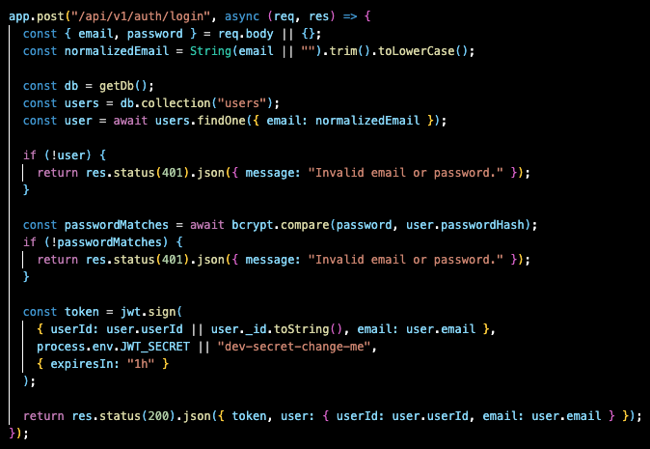
Project - APIs - Login API

Slide 60
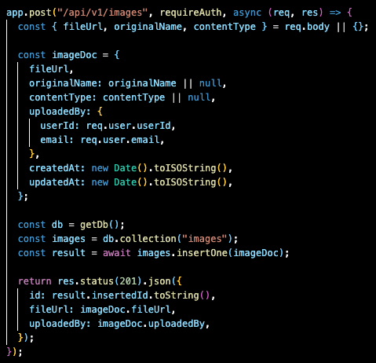
Project - APIs - Upload Image API

Slide 61
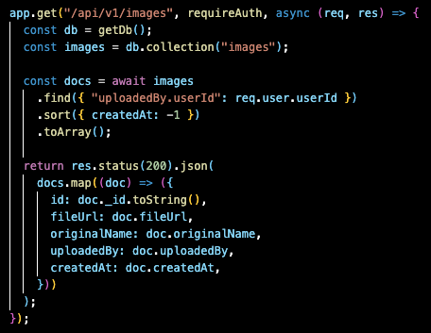
Project - APIs - Get Images API

Slide 62
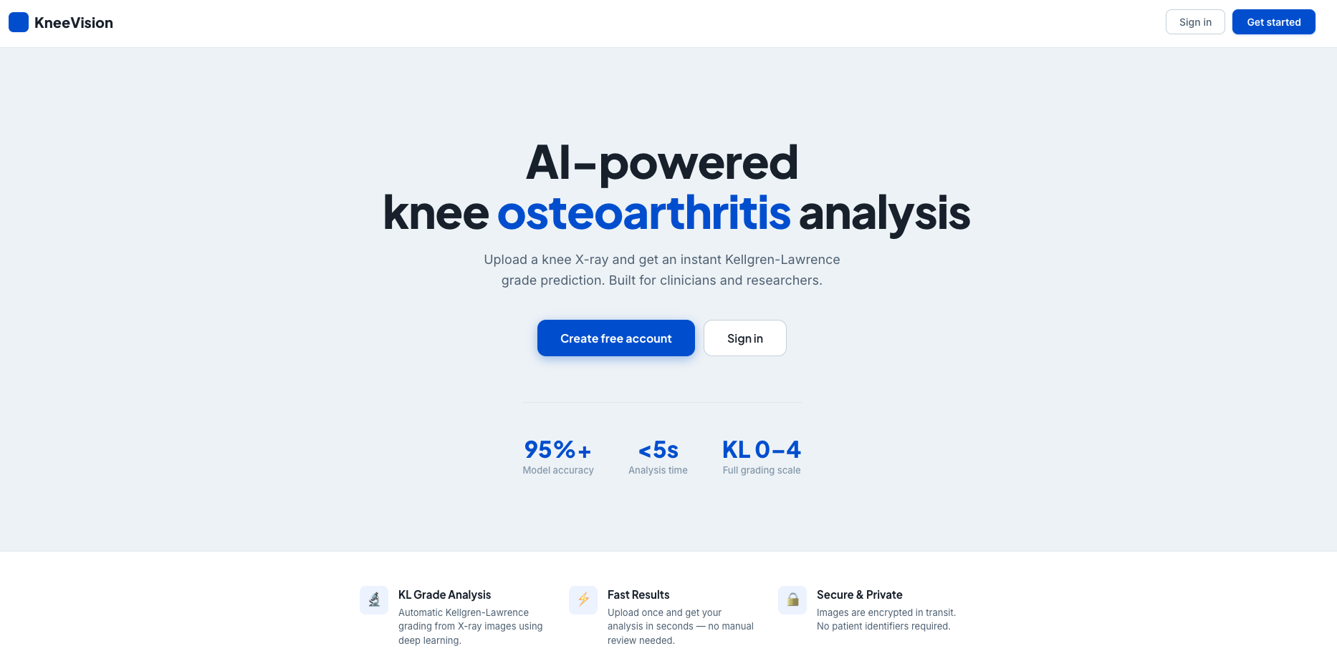
Project Demo - Application Screenshots

Slide 63
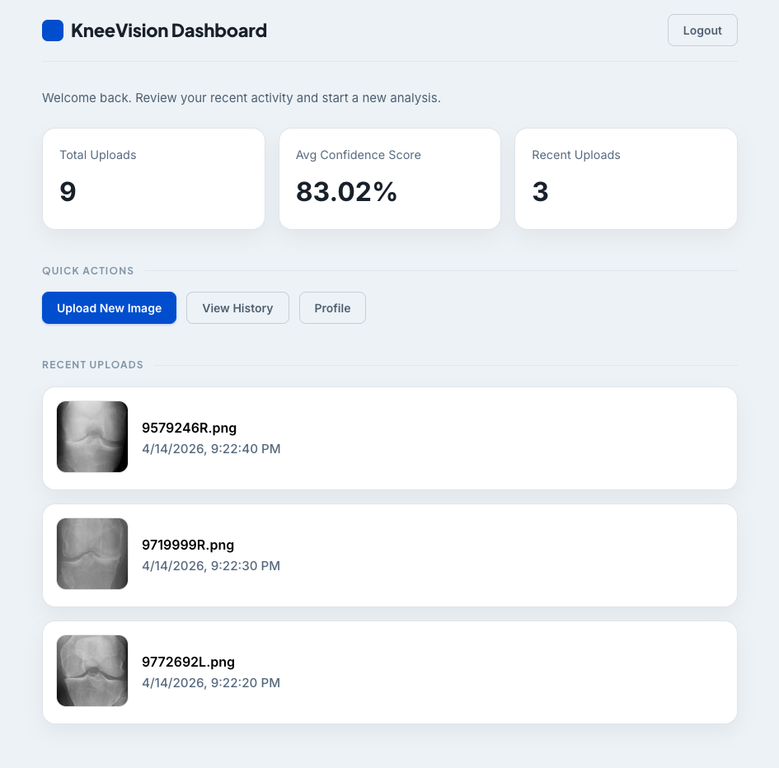
Project Demo - Application Screenshots

Slide 64
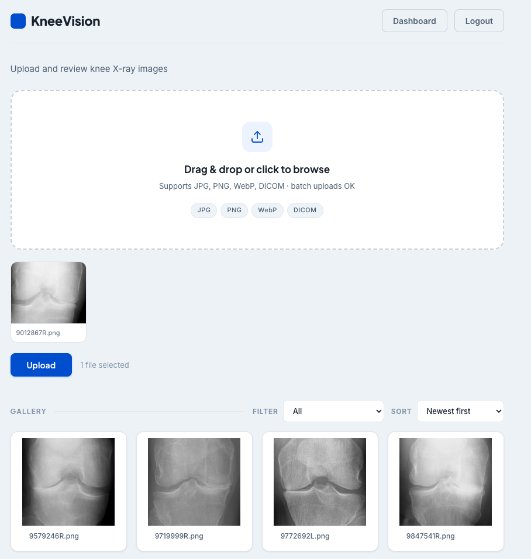
Project Demo - Application Screenshots

Slide 65
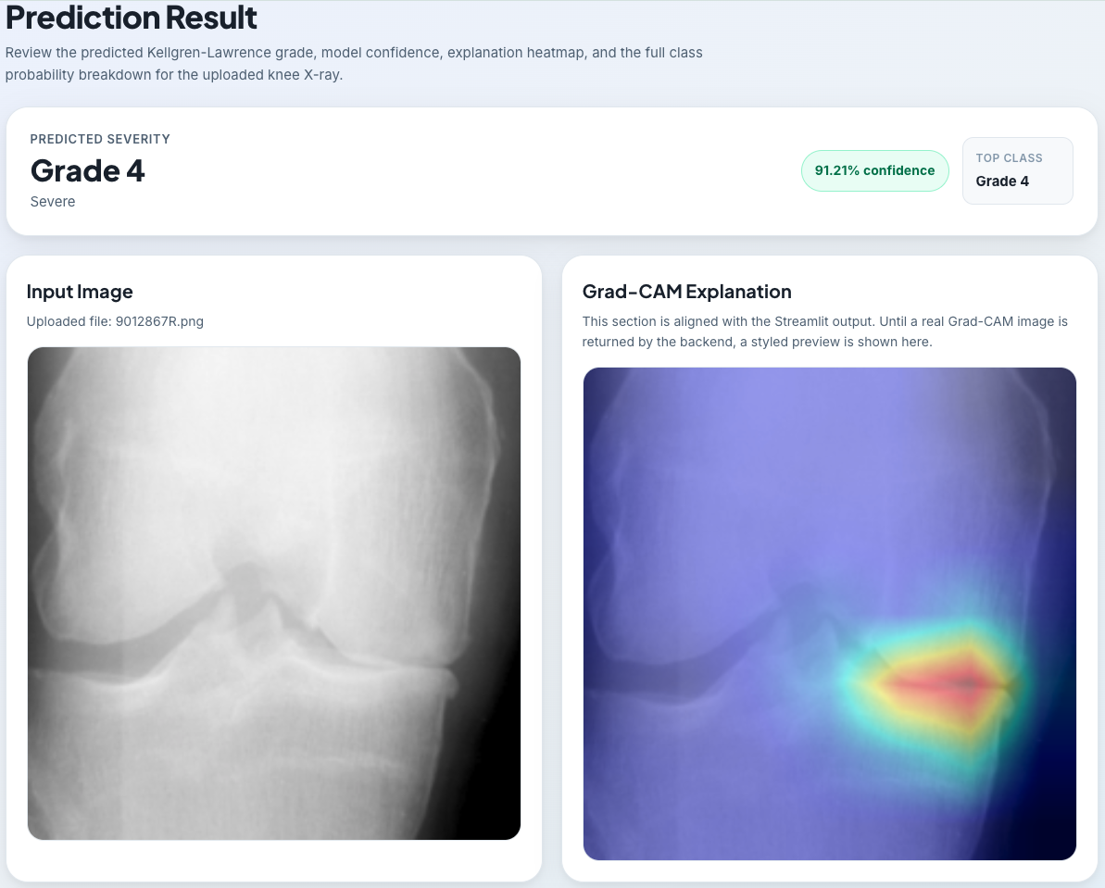
Project Demo - Application Screenshots

Slide 66
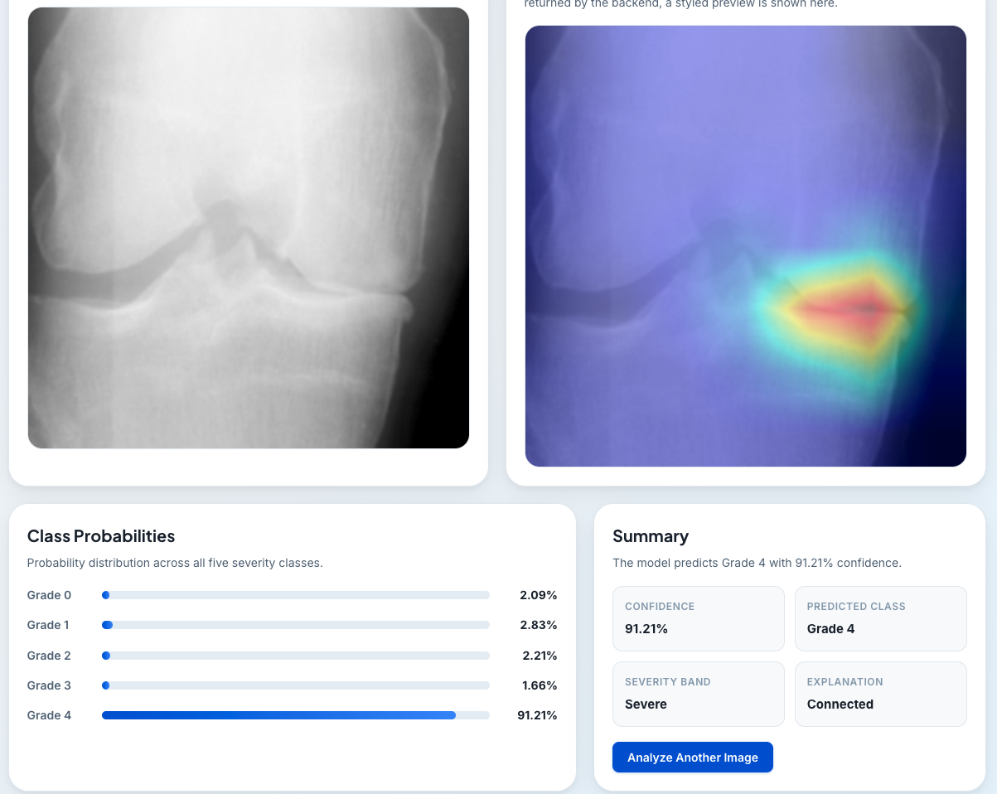
Project Demo - Application Screenshots

Slide 67
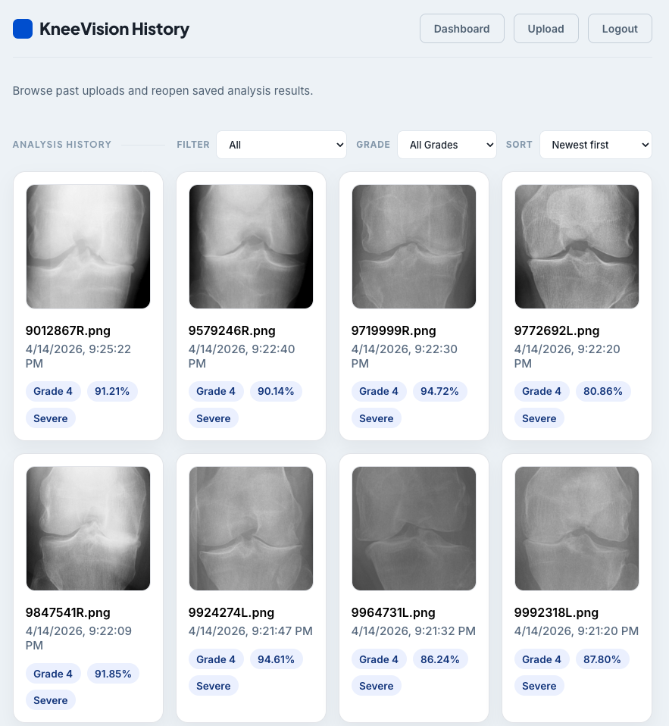
Project Demo - Application Screenshots

Slide 68
Wiki Page Link
https://github.com/htmw/STARLABS/wiki#kneevision

Slide 69
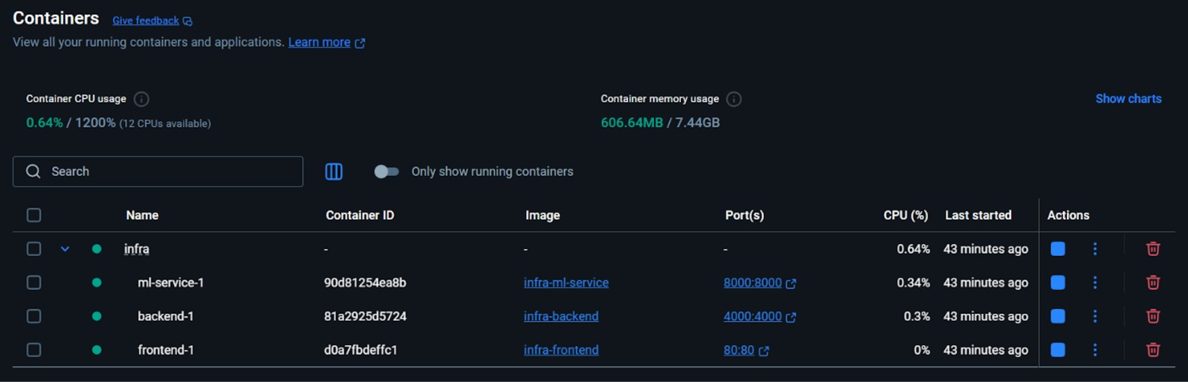
Docker:

Slide 70
Live Application Demo

Slide 71
AI Disclosure
Assisted in generating initial user stories and backlog items
Helped draft test cases and testing scenarios
Supported development of specific backend API routes (authentication, image upload, and database integration) and frontend components (forms, state handling, and API calls)
Provided guidance for debugging and resolving errors
Assisted with structuring documentation and project artifacts

Slide 72
THANK YOU
Team S.T.A.R Labs

